Slide 1
Test Phases:
1. Low-Mid Load
2. High Load
3. Idle-Low Load

Slide 2
Test Phases:
1. Low-Mid Load
2. High Load
3. Idle-Low Load

Slide 3
Test Phases:
1. Low-Mid Load
2. High Load
3. Idle-Low Load

Slide 4
Test Phases:
1. Low-Mid Load
2. High Load
3. Idle-Low Load

Slide 5
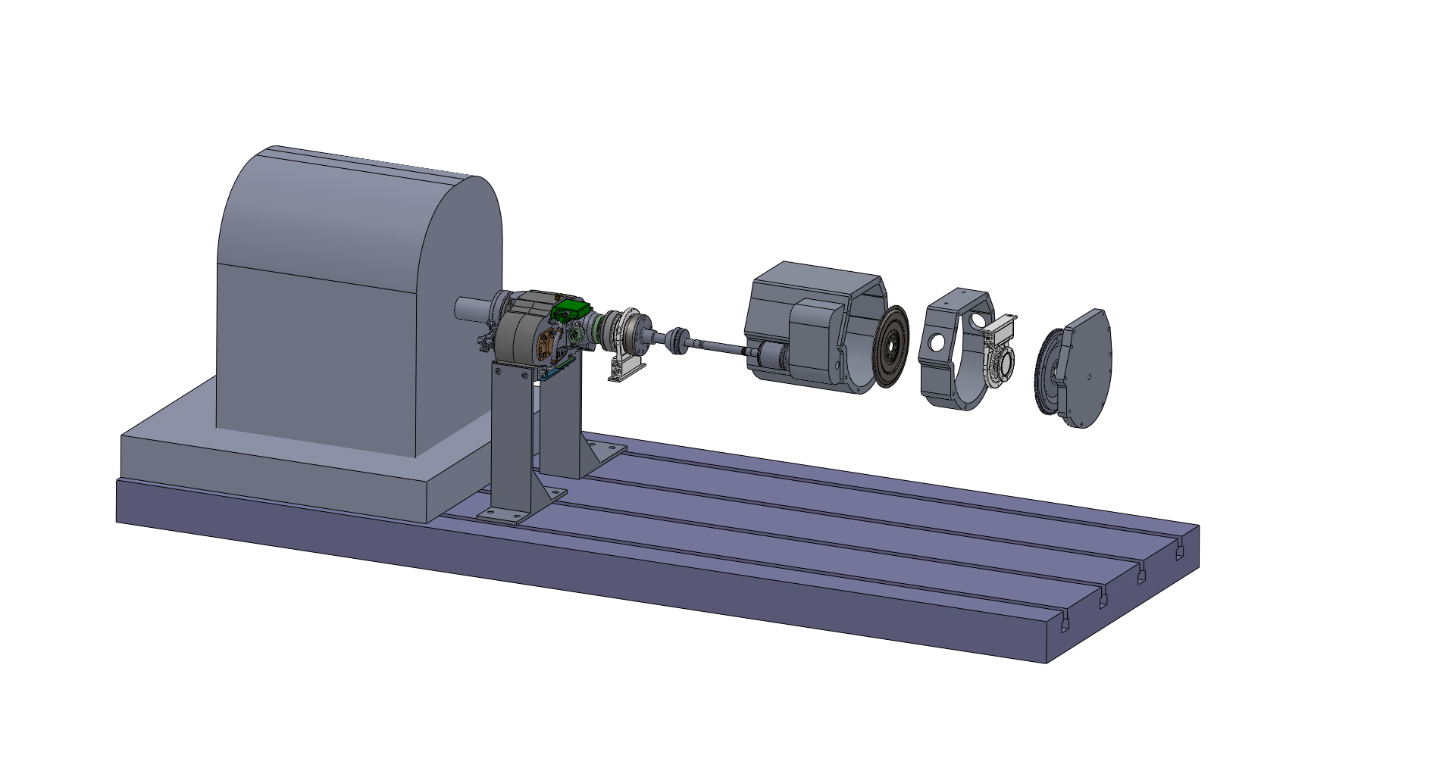
Auxiliary transmission
CVT and torque converter
Dyno
HBM torque sensor
HBM torque sensor
Engine and flywheel
Spacer

Slide 6
Local Power Supply
Chassis Signals
Data Acquisition System
ECU
Battery
Key Signals
Charger
Test Cell Engine
CAN Bus
Ground
#1 AWG
Ground Only

Slide 7
Pedal Sweep of Honda 1.5L Turbo Engine with CVT Output Shaft at Zero Speed
X - Pedal Sweep while in CVT in drive (pedal = 0 to ~13% with CVT output shaft at 0 rpm)
Idle point with pedal=0 and CVT in drive
+ - Pedal Sweep while in CVT in neutral (pedal = 0 to ~20% with CVT output shaft at 0 rpm)
Idle point with pedal=0 and CVT in neutral

Slide 8
“Initial”
high-load interval
“Final”
high-load interval

Slide 9
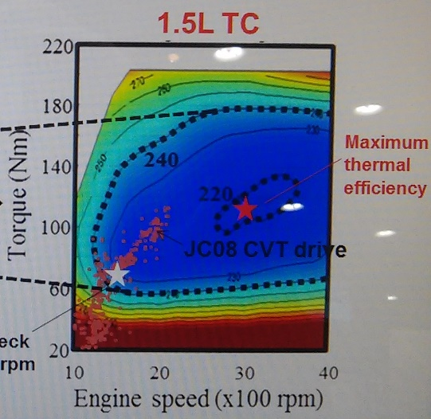
Honda’s Published BSFC maps
from SAE Paper:
from SAE World Congress:
1.5L TC
1.5L TC
Maximum thermal efficiency
Torque [Nm]
Torque [Nm]
Engine speed [x100 rpm]
Engine speed [x100 rpm]

Slide 10
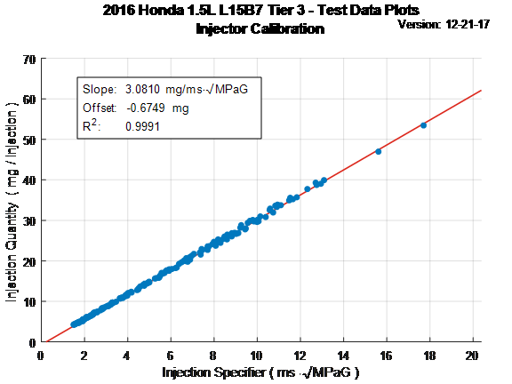
2016 Honda 1.5L L15B7 Tier3 –Test Data Plots Injector Calibration
Version: 12-21-17
Injection Quantity ( mg / injection )
Injection Specifier (ms * √MPaG)

Slide 15
Figure 8. Injector calibration data

